Slide 1
Detection of harmful objects for kidsonline video parsing and analysis
Oliver O’Connor

Slide 2
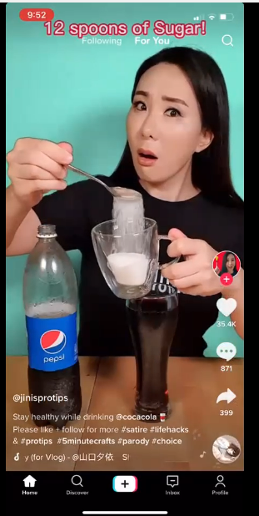
Project Goals
Detection of harmful objects in KidsOnline study’s data
The study involves groups of school-age children and records sessions of their device activity.
For this project, we want to be able to classify objects in these recordings so that the researchers at wellington can quickly identify scenes that contain marketing.

Slide 3
Sodanet
https://github.com/UMass-Rescue/SodaNet
The first model, looked quite promising but had some problems that were important to solve for the rest of the project.
No scalability – this model classifies coke bottles, there is almost no reusability for this model.
Other models can do what it does better and faster
Because it identifies bottles and not logos/brands, there are many false positives, almost every soda drink comes in the soda shaped bottle. But there are also other forms of coke and importantly, other forms of marketing apart from the bottle itself.

Slide 4
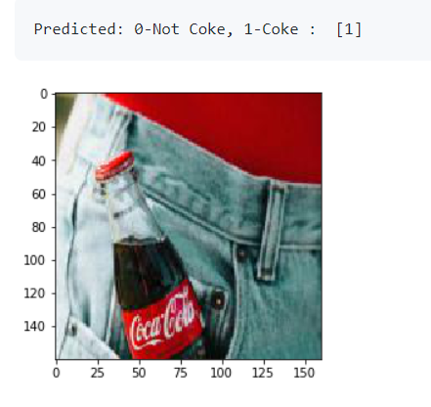
Sodanet
https://github.com/UMass-Rescue/SodaNet
From my experience with the model, it was very inaccurate.
Learning to recognize red and white blobs, the github used images that contained coke and didn’t contain coke as a measure for accuracy.
Introduce any images of objects that were red and white. The model thought it was coke.

Slide 5
YOLOv5
https://github.com/PiotrG1996/JetsonNano_ObjectDetection_YOLOv5
A very efficient model that can make predictions in almost real-time
Has some of the problems that sodanet has, in which the model identifies bottles not logos
This model, like sodanet, also helped to show some of the potential problems that needed to be solved for the project, bit of a dilemma on what you consider marketing. Is the absence of a logo on a bottle of soda still considered marketing? etc

Slide 6
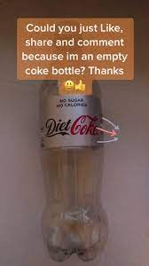
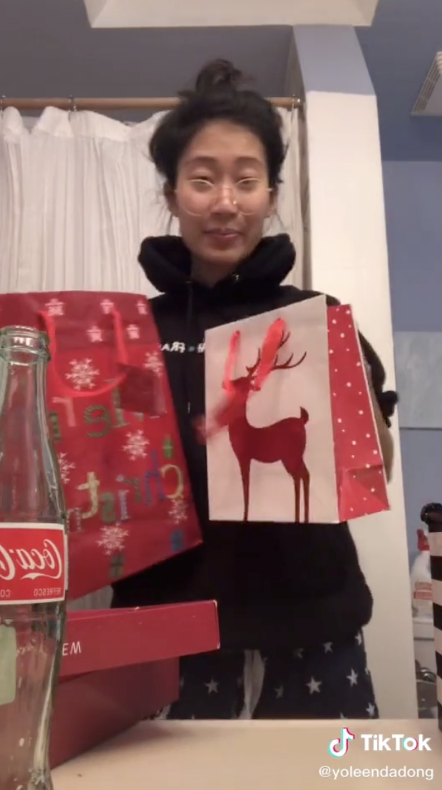
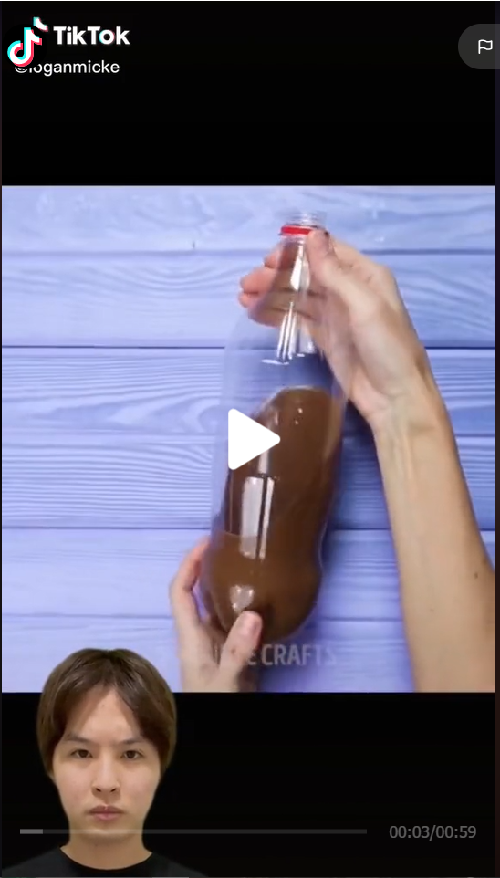
Marketing vs not?
This should be flagged This will be flagged but should it? This shouldn’t be flagged
Some models classify coke through colour, contour of the bottle and other features, maybe the bottle isn’t what we should be identifying

Slide 7
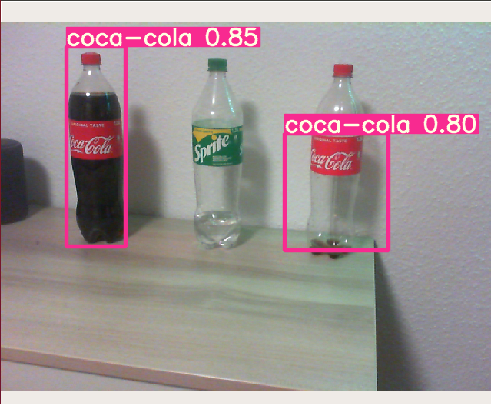
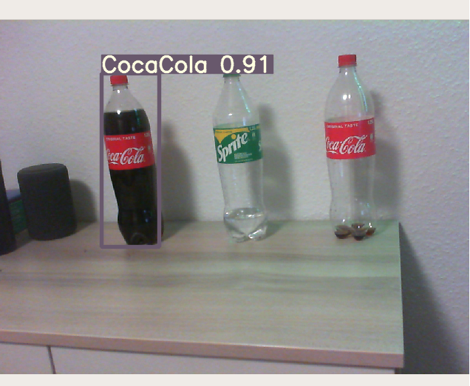

Slide 8
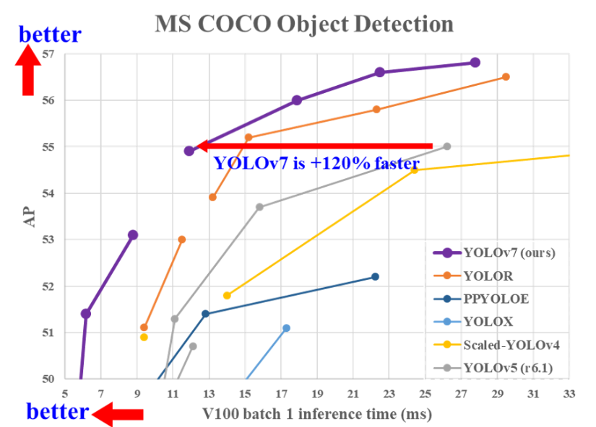
YOLOv7
https://github.com/WongKinYiu/yolov7
Like YOLOv5 but faster
Modern and quite prominent at the moment in object-recognition
Could get demos working but training this model to recognize logos and/or coke bottles could be its own research project.

Slide 9
DeepLogo
https://github.com/satojkovic/DeepLogo
A brand logo detection system using Tensorflow Object Detection API.
Almost perfect for what is needed.
Quite good performance however DeepLogo2 is available and boasts improvements over the original, most important of which is the ability to fine tune the network.

Slide 10
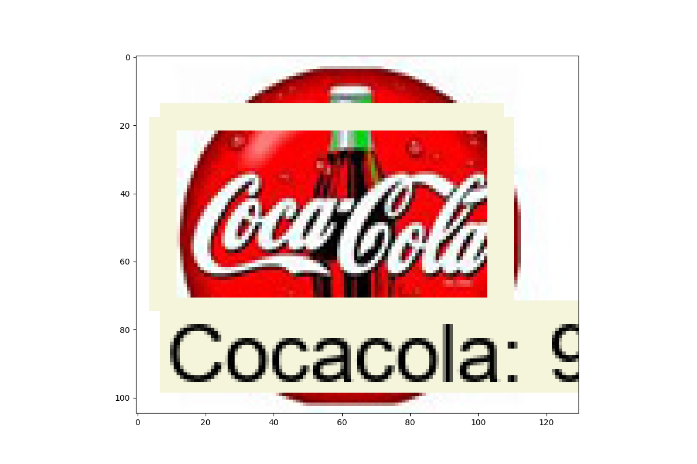

Slide 11
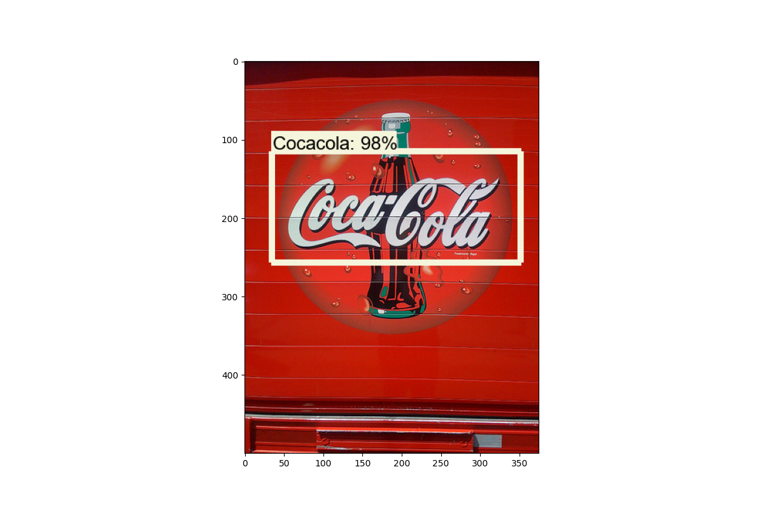

Slide 12
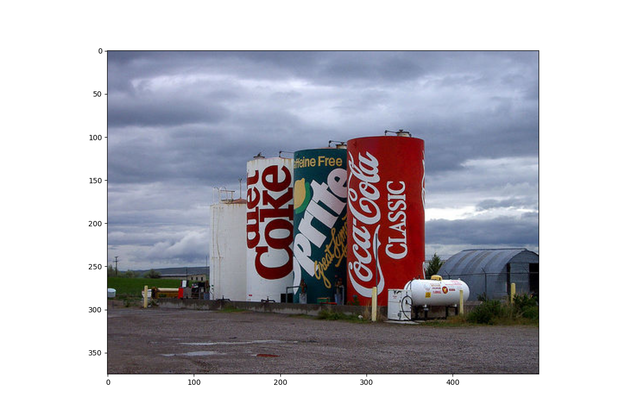
Not Perfect!

Slide 13
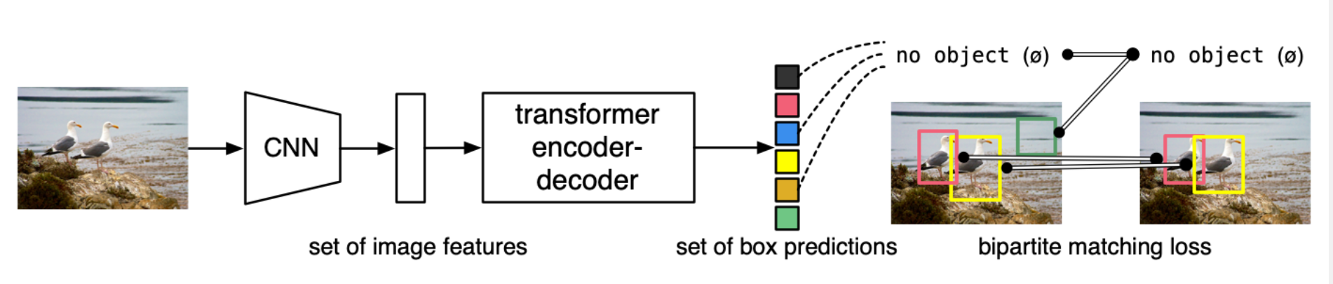
DeepLogo2, based on DETR
A brand logo detection system using DETR.
(DETR) End-to-End Object Detection with Transformers
DETR is quite complicated but allows for the majority of outputs to be produced in parallel, resulting in a very fast and efficient model so it can make better predictions in the same amount of time as other object detection models.

Slide 14
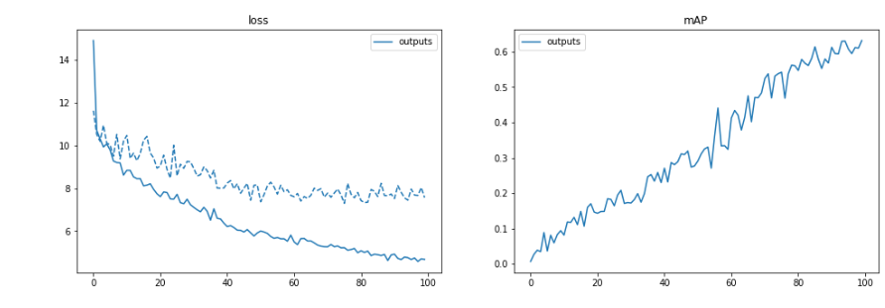
Some Metrics (over 100 epochs)

Slide 15
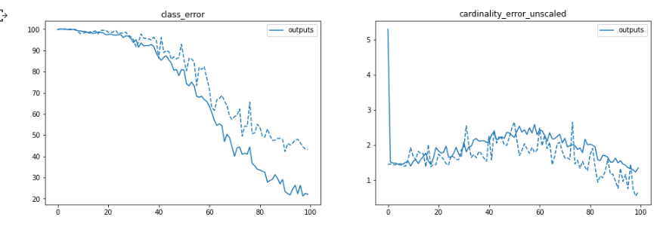
Some Metrics (over 100 epochs)

Slide 16
Deeplogo2 Run-Through

Slide 17
Problems
Although logo recognition has good performance and accuracy, the prediction is reliant on the quality of the input images.
In the KidsOnline study, some of the video recordings are of lower quality, which impact the performance of the model.
This may be a limitation of using a machine learning approach for this data, or there may be improvements that I haven’t explored?

Slide 18
The Future!
Currently there are 3 things that I’ve thought of that could be done with the project.
Pre-processing Images to see how they improve prediction results.
Currently can classify 27 logos, There are annotated datasets available with up to 3000 logos. It would be possible to train models to be able to classify logos of importance. https://arxiv.org/pdf/2008.05359.pdf
Potentially some filtering with use of multiple models and predictions, i.e General object recognition model such as detr to identify bottles, signposts, billboards etc. Further models could categorize those objects through logo etc.

Slide 19
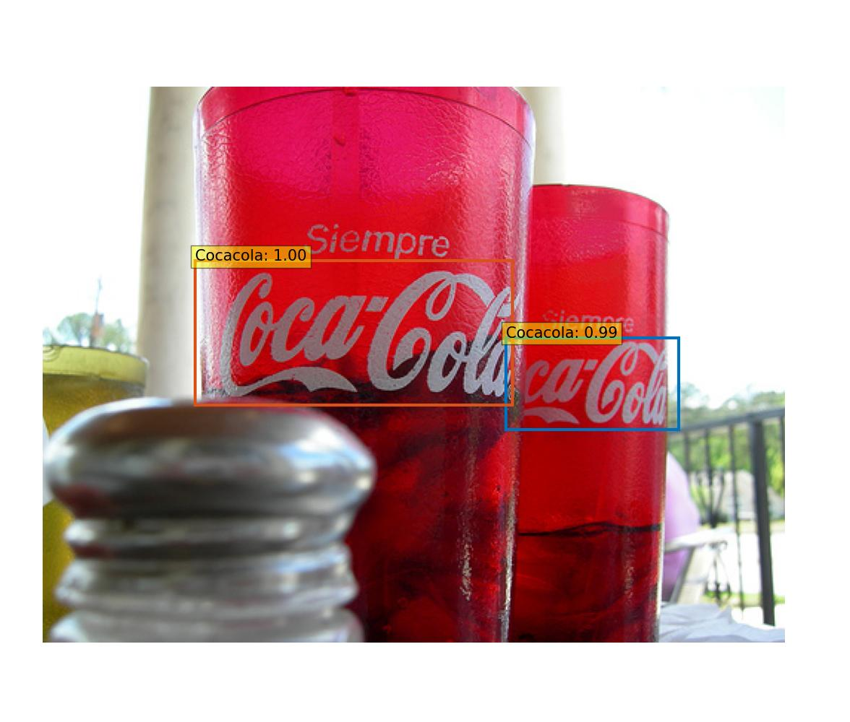
Thanks For attending!
Questions?

